Slide 1
Decision Tree Classification

Slide 2
Decision Tree Classification

Slide 3
Overview
In this webinar we’ll learn Decision Tree Classification, attribute selection measures, and how to build and optimize Decision Tree Classifier using Python Scikit-learn package for a given Use Case.

Slide 4
Step by Step Process
Decision Tree Algorithm
How does the Decision Tree algorithm work?
Attribute Selection Measures
Information Gain
Gain Ratio
Gini index
Optimizing Decision Tree Performance
Classifier Building in Scikit-learn

Slide 5
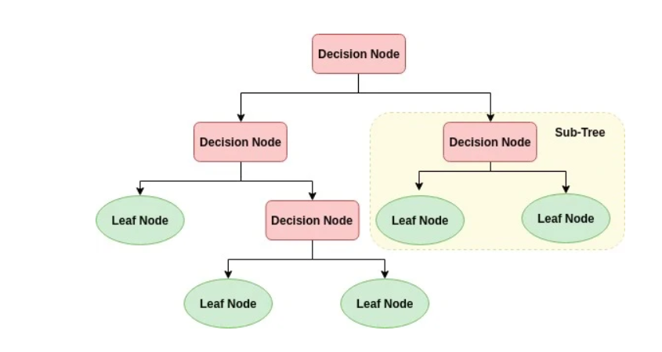
Decision Tree Algorithm
Decision Tree is a white box type of ML algorithm. It shares internal decision-making logic, which is not available in the black box type of algorithms such as Neural Network.
Its training time is faster compared to the neural network algorithm. The time complexity of decision trees is a function of the number of records and number of attributes in the given data. The decision tree is a distribution-free or non-parametric method, which does not depend upon probability distribution assumptions. Decision trees can handle high dimensional data with good accuracy

Slide 6
How does the Decision Tree algorithm work?
The basic idea behind any decision tree algorithm is as follows:
Select the best attribute using Attribute Selection Measures(ASM) to split the records.
Make that attribute a decision node and breaks the dataset into smaller subsets.
Starts tree building by repeating this process recursively for each child until one of the condition will match:
All the tuples belong to the same attribute value.
There are no more remaining attributes.
There are no more instances.

Slide 7
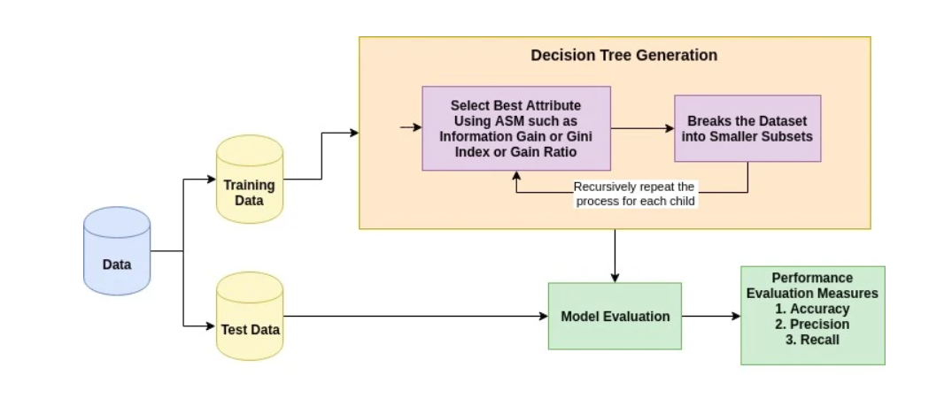
How does the Decision Tree algorithm work?

Slide 8
Attribute Selection Measures
Attribute selection measure is a heuristic for selecting the splitting criterion that partition data into the best possible manner. It is also known as splitting rules because it helps us to determine breakpoints for tuples on a given node. ASM provides a rank to each feature(or attribute) by explaining the given dataset. Best score attribute will be selected as a splitting attribute. In the case of a continuous-valued attribute, split points for branches also need to define. Most popular selection measures are Information Gain, Gain Ratio, and Gini Index.

Slide 9



Information Gain/Entropy
Shannon invented the concept of entropy, which measures the impurity of the input set. In physics and mathematics, entropy referred as the randomness or the impurity in the system. In information theory, it refers to the impurity in a group of examples. Information gain is the decrease in entropy. Information gain computes the difference between entropy before split and average entropy after split of the dataset based on given attribute values. ID3 (Iterative Dichotomiser) decision tree algorithm uses information gain.
Where, Pi is the probability that an arbitrary tuple in D belongs to class Ci.

Slide 10
Information Gain/Entropy
Where,
Info(D) is the average amount of information needed to identify the class label of a tuple in D.
|Dj|/|D| acts as the weight of the jth partition.
InfoA(D) is the expected informa-tion required to classify a tuple from D based on the partitioning by A.
The attribute A with the highest information gain, Gain(A), is chosen as the splitting attribute at node N().

Slide 11
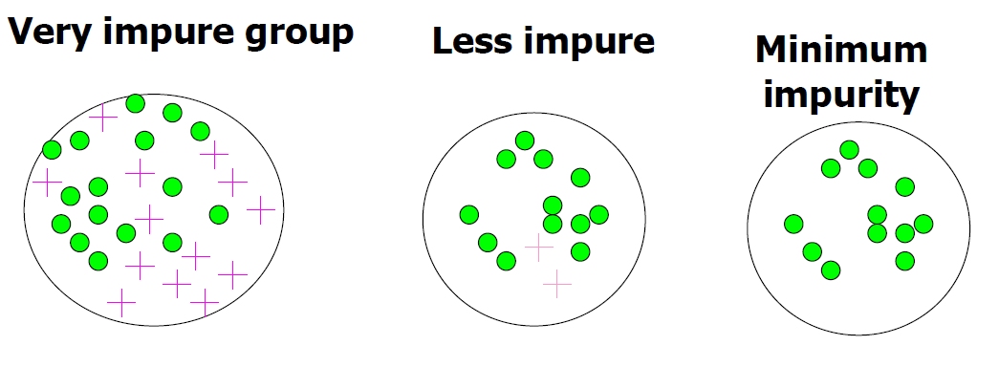
Information Gain/ Entropy
Impurity

Slide 12
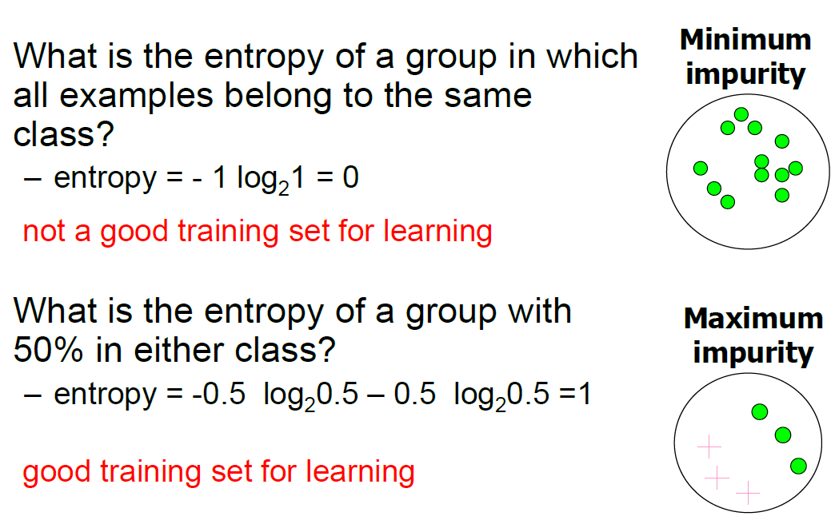
Information Gain/ Entropy

Slide 13
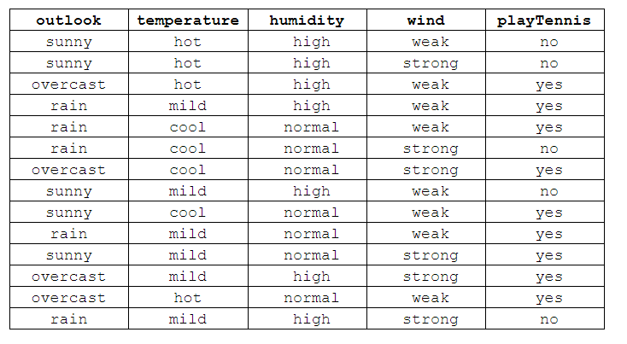
Decision Tree – Manually
Data Set

Slide 14
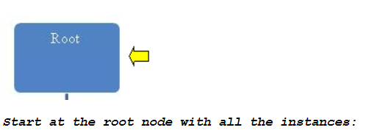

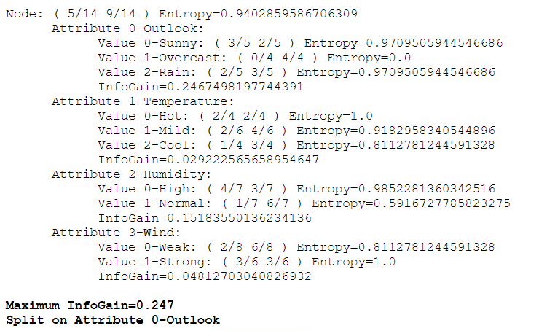
Decision Tree – Manually

Slide 15
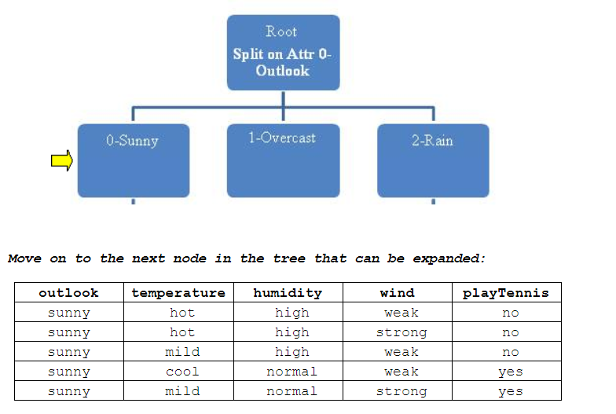
Decision Tree – Manually

Slide 16
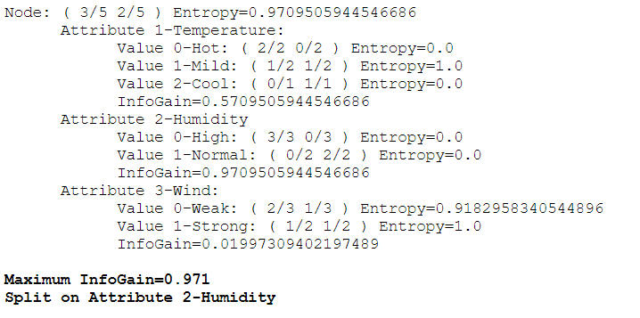
Decision Tree – Manually

Slide 17
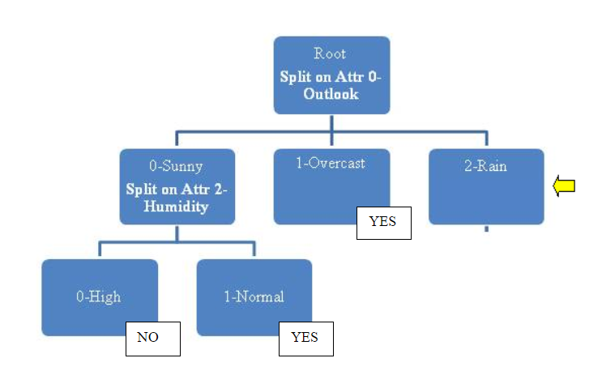
Decision Tree – Manually

Slide 18
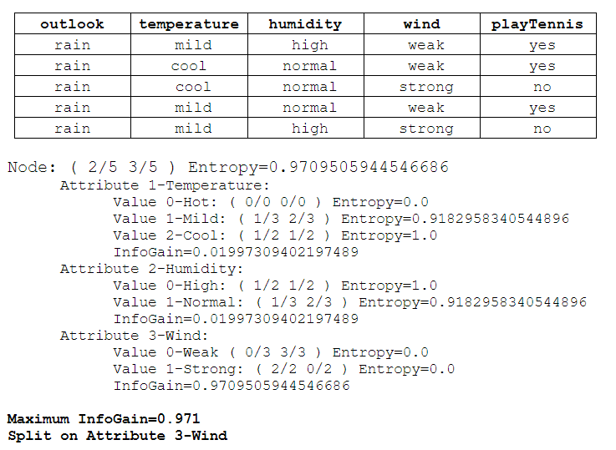
Decision Tree – Manually

Slide 19
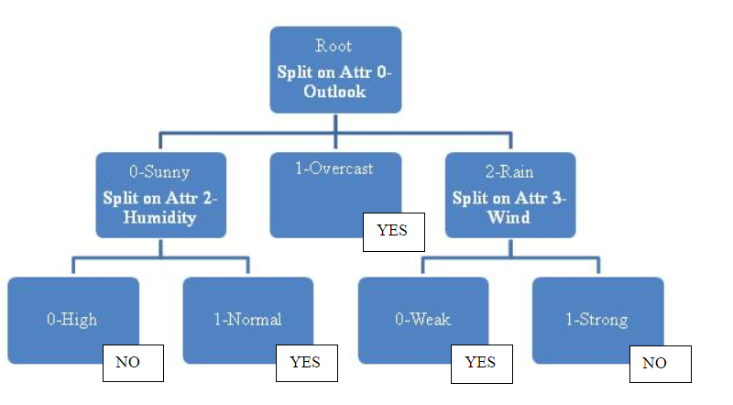
Decision Tree – Manually

Slide 20
Decision Tree Implementation: Demo

Slide 21
Appendix : Use Case Discussion

Slide 22
Use Case
As a marketing manager, you want a set of customers who are most likely to purchase your product. This is how you can save your marketing budget by finding your audience. As a loan manager, you need to identify risky loan applications to achieve a lower loan default rate. You have to identify customers into a group of potential and non-potential customers or to identify safe or risky loan applications.

Slide 23
Use Case – Step by Step Solution
Data Description
Data Exploration
Data Pre-processing & Cleaning
Feature Vector Extraction
Split Data Set into 70% & 30% etc
Model Preparation
Execute Algorithm
Test Model against Test Data
Find Accuracy of Model

Slide 24
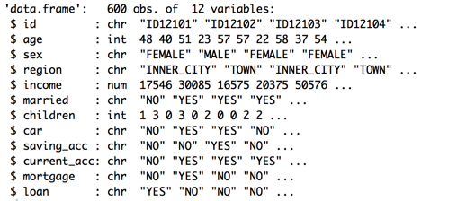
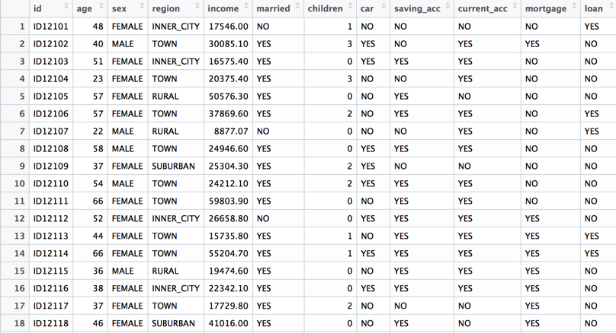
Data Description
Dataset Columns and Format
Sample Data

Slide 25
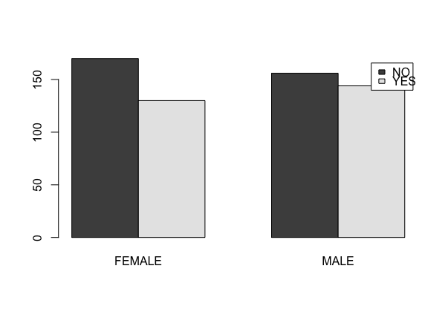
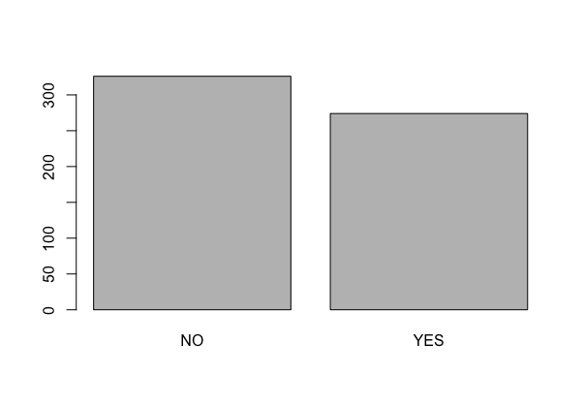
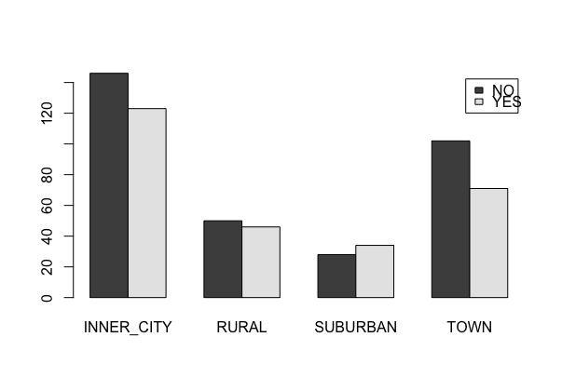
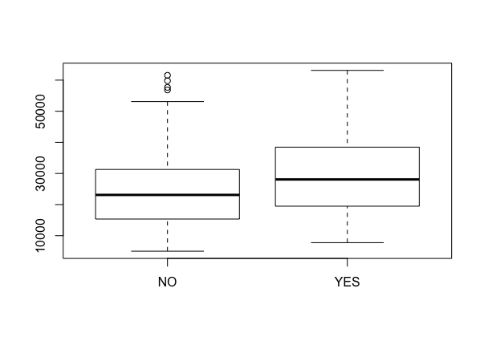
Data Exploration
Loan distribution
Gender VS Loan
Income VS Loan
Region VS Loan

Slide 26
Data Exploration
Correlation between Age, Income and Children
Column | Column | Correlation
Age | Income | 0.7 (Highly Correlated)
Age | Children | 0.02 (Low Correlation)
Income | Children | 0.03 (Low Correlation)

Slide 27
Data Pre-processing & Cleansing
Replace All Null Values
Replace all missing values
Decision to either consider records with empty values or correct them

Slide 28
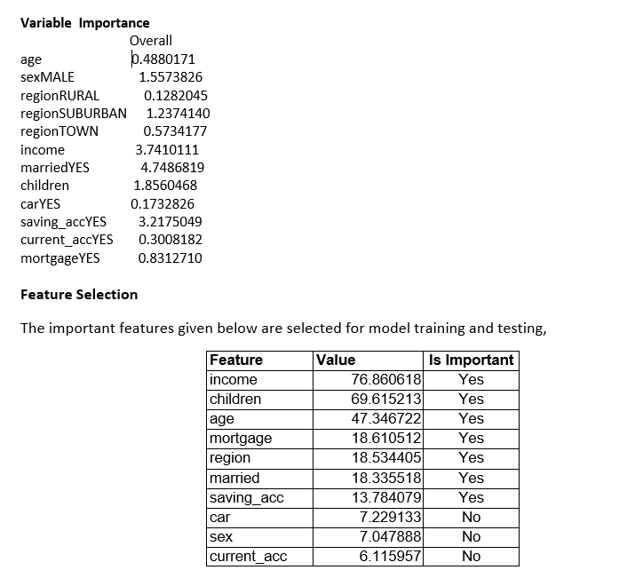
Feature Vector Extraction

Slide 29
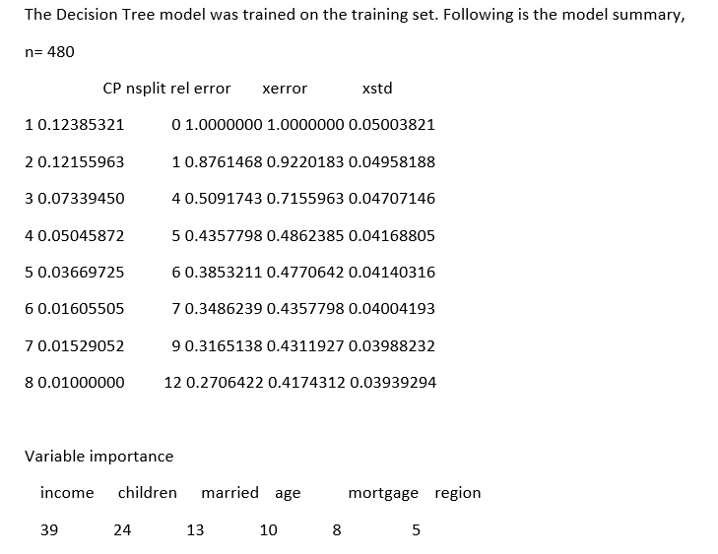
Preparation Model & Test Data
Split the Model in 70 % of Training Data & 30% of Test Data
Split the Model in Various ratios to check accuracy of model.

Slide 30
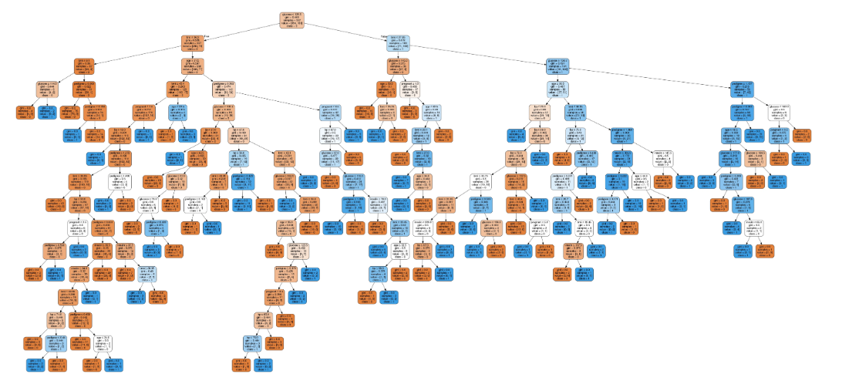
Decision Tree of Use Case

Slide 31
Thank You!!

